Slide 1
What data are available, and how are they accessed?

Slide 2
Providers of information
Health & Social Care Information Centre
HSCIC
Office for National Statistics
ONS
UK and Ireland Cancer Registries UKIACR
National Audits
PHE
including
Health Intelligence Networks
NHS England Business Intelligence Teams
Incisive
Health
Macmillan Cancer Support
Cancer Research UK
Dr Foster and other intermediaries

Slide 3
Cancer data tools
Cancer Statistics
CAS
Intelligence Tools
CCT & Local Cancer Intelligence
Strategic Tools
Shape (Strategic Health Asset Planning and Evaluation)
Mapping Tools
GIS (Geographic information system)
CHI (Clinical Headline Indicators)
Cascade (Cancer Analysis System)
COSD
Fingertips (PHOF/ Tobacco profiles)
Audit
CWT
SACT
DIDs
RTDS
HES
SPOT (Spend & Outcome tool)
E Atlas
Commissioning for Value Packs

Slide 4
PHE data and knowledge gateway
http://datagateway.phe.org.uk/
Intelligence

Slide 5
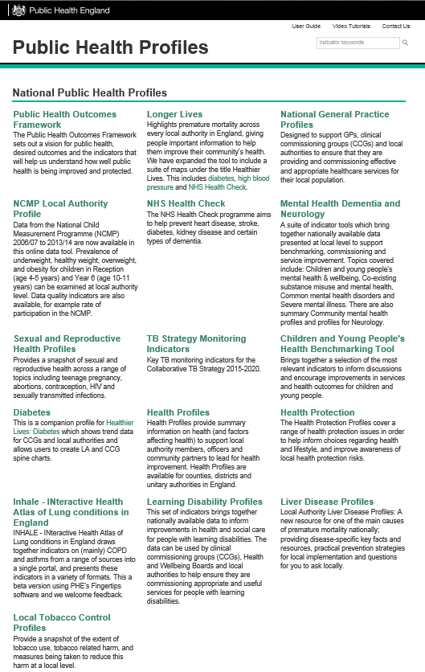
Public Health Profiles (Fingertips)
http://fingertips.phe.org.uk/
Type in ‘cancer’ in the search box
Intelligence

Slide 6
Public Health Outcomes Framework
http://www.phoutcomes.info/
NEW: compare indicators
Intelligence

Slide 7
Local Tobacco Control Profiles
http://tobaccoprofiles.info/
Intelligence

Slide 8
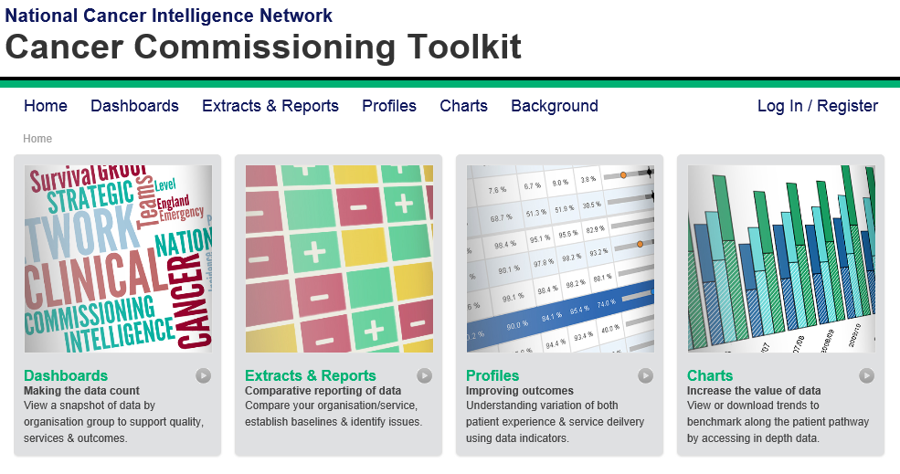
Cancer Commissioning Toolkit (CCT) https://www.cancertoolkit.co.uk/
‘Supporting World Class Commissioning
of Cancer services across the NHS’
Intelligence
Types of Data available by charts:
Incidence; Emergency Presentations; Mortality; Place of Death; Survival; Smoking Cessation; Peer Review; Screening; Staging, Referrals; Waiting Times; Radiotherapy; National Audit; Expenditure.
Profiles :
Service profiles; CCG & GP profiles.
Extracts & Reports :
Cancer Prevalence; Enhanced Recovery; horizon Scanning; HES; LAPCO; Routes to Diagnosis;; Cancer Nurse Specialist; Chemotherapy Nursing Workforce; Peer Review reports; Dashboards.

Slide 9
Local Cancer Intelligence
http://lci.cancertoolkit.co.uk/
Intelligence
Source: National Cancer Intelligence Network. 2014. Macmillan-NCIN work plan - Segmenting the cancer population: All malignant neoplasms combined and top four cancer types by Clinical Commissioning Group, 20-year cancer prevalence for the period 1991-2010, England.

Slide 11
Cancer Stats: CHI https://nww.cancerstats.nhs.uk/users/sign_in
Intelligence

Slide 12
Cancer Stats: CASCADE https://nww.cancerstats.nhs.uk/users/sign_in
Intelligence

Slide 13
NCIN http://www.ncin.org.uk/home
Intelligence
Download the
‘What cancer stats are available?’ guide

Slide 14
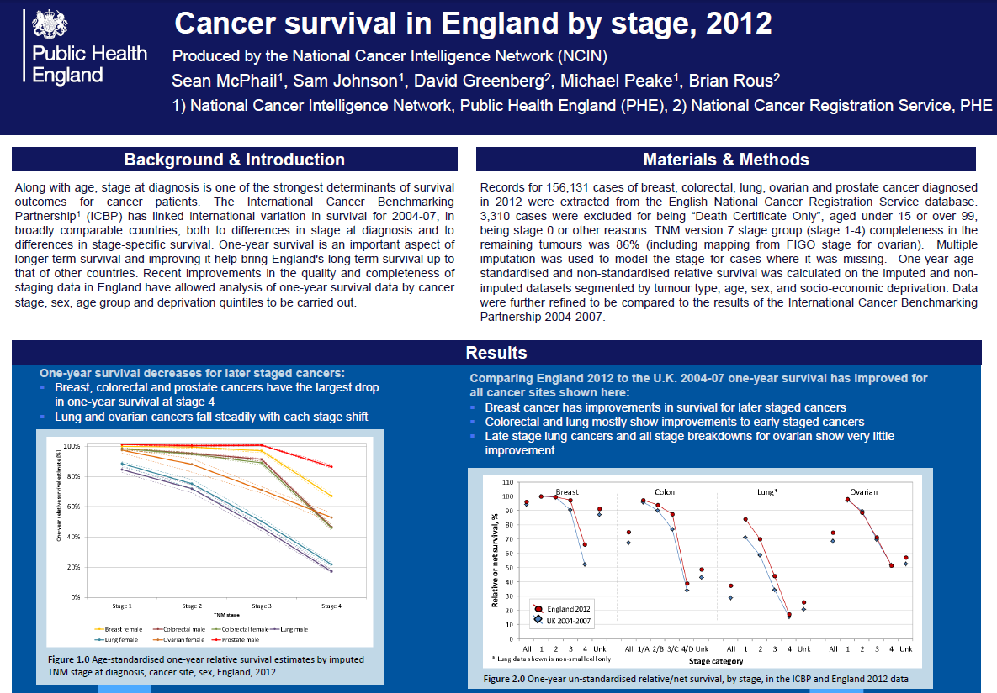
Bespoke analyses
Survival by stage
Outpatient analysis
Intelligence

Slide 15
Bespoke analyses
Routes to diagnosis
Intelligence

Slide 16
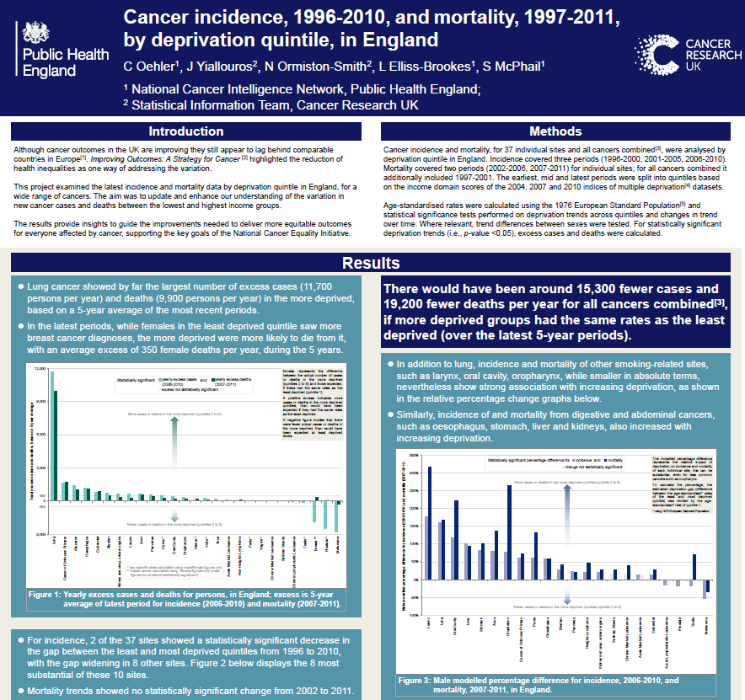
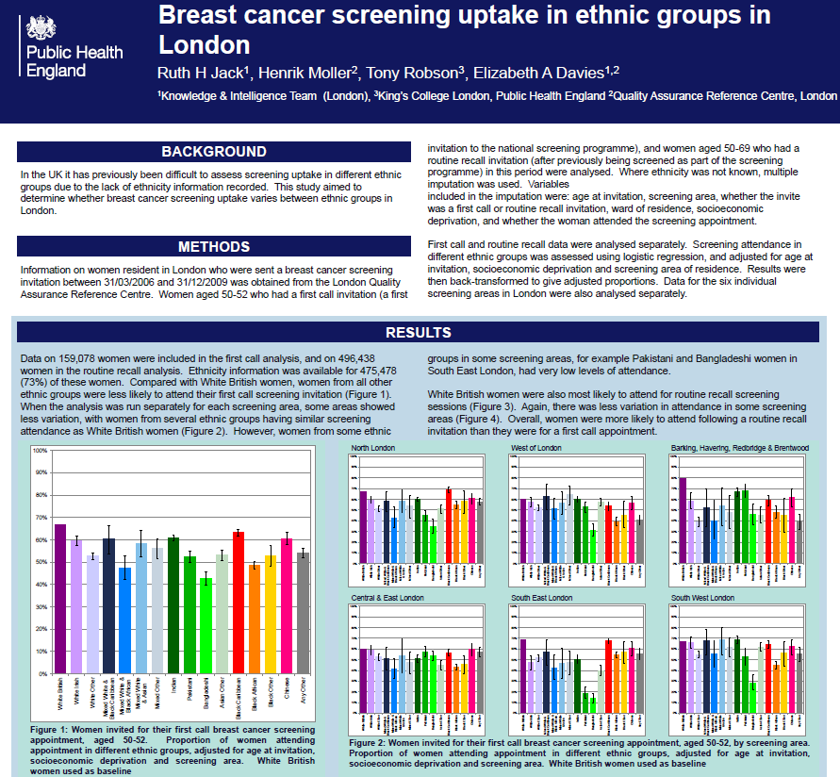
Bespoke analyses
Inequalities: deprivation ethnicity
Intelligence

Slide 17
Bespoke analyses - treatment

Slide 18
PHE Office for Data Release
The PHE Office for Data Release (ODR) ensures that requests for potentially or explicitly identifiable data are managed in line with PHE’s statutory responsibilities as a data controller, so that:
Any data sharing complies with the rights of the data subject, Data Protection Act and Caldicott principles;
There is an appropriate legal gateway for the receiving organisation to receive and process patient or personal data;
The physical transfer of the data is secure; and,
The receiving organisation can satisfy that they have in place comparable controls to ensure that the data is held securely.
Submission to the ODR
(ODR@phe.gov.uk)
Review of application and approvals
Data re-use agreement
Data release
Publication of release
Required documents
Protocol
Data specification
REC approval (for research only)
Legal gateway to process the data
IG toolkit level 2 compliance or equivalent
Intelligence
On average 6 weeks to release
Data Re-use Agreement
A Data Re-use Agreement (DRA) must be signed between PHE and the applicant prior to the release of the data. The DRA binds the application to specific terms of the release of the data, including agreeing to not to disclose, use or reuse the data outside the conditions of the approved release (the study protocol and associated ethics, legal permissions).
Data available through the ODR:
NCRS cancer registration data
National Cervical Cancer Screening
National Breast Screening Programme
National Bowel Cancer Screening Programme
National Drug Treatment Monitoring Dataset
Congenital Anomalies Register
Data Release Register
PHE is committed to sharing all instances in which potentially or explicitly data is released, through the publication of a PHE Data Release Register. The first register to be published in 2015.

Slide 19
Contact us
Local: Rebecca.elleray@phe.gov.uk
National/general: enquiries@ncin.org.uk
ncinanalysts@phe.gov.uk
Intelligence

